Slide 1
Basic Data Analysis
Final Project Presentation by Kristy Bloxham

Slide 2
Description of Data in Species_info
This dataset contains the following categories of data:
Category-Describes what type of species
Mammal, Reptile, Amphibian, Fish, Vascular Plan or Nonvascular plant
Scientific Name of each species
Common Name of each species
Protected Species Status
Species of Concern, Endangered, Threatened, In Recovery, or Non Protected

Slide 3
Endangered Species Findings
conservation_status scientific_name 0 Endangered 15 1 In Recovery 4 2 No Intervention 5363 3 Species of Concern 151 4 Threatened 10
conservation_status scientific_name 0 Endangered 15 1 In Recovery 4 2 No Intervention 5363 3 Species of Concern 151 4 Threatened 10
Of the 7 categories of species the following observations were found:
Conservation Status | Number Identified
Endangered | 15
In Recovery | 4
No Intervention | 5363
Species of Concern | 151
Threatened | 10

Slide 4
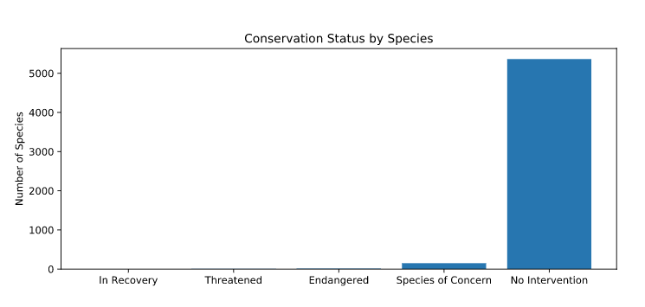
Endangered Species Findings
conservation_status scientific_name 0 Endangered 15 1 In Recovery 4 2 No Intervention 5363 3 Species of Concern 151 4 Threatened 10
conservation_status scientific_name 0 Endangered 15 1 In Recovery 4 2 No Intervention 5363 3 Species of Concern 151 4 Threatened 10
Of the 7 categories of species the following observations were found:

Slide 5
Endangered Species Findings
conservation_status scientific_name 0 Endangered 15 1 In Recovery 4 2 No Intervention 5363 3 Species of Concern 151 4 Threatened 10
conservation_status scientific_name 0 Endangered 15 1 In Recovery 4 2 No Intervention 5363 3 Species of Concern 151 4 Threatened 10
Of the 7 categories of species the following observations were found:
Category | Not-Protected | Protected | Percentage
Amphibian | 72 | 7 | 8
Bird | 413 | 75 | 15
Fish | 115 | 11 | 8
Mammal | 146 | 30 | 17
Nonvascular Plant | 328 | 5 | 1.5
Reptile | 73 | 5 | 6.4
Vascular Plant | 4216 | 46 | 1

Slide 6
Endangered Species Findings
conservation_status scientific_name 0 Endangered 15 1 In Recovery 4 2 No Intervention 5363 3 Species of Concern 151 4 Threatened 10
conservation_status scientific_name 0 Endangered 15 1 In Recovery 4 2 No Intervention 5363 3 Species of Concern 151 4 Threatened 10
Are some species more likely to be endangered than others:
We found that there was not a significant difference between whether Mammals and Birds were protected.
We did find a significant difference between Mammals and Reptiles as Mammals are much more likely to be protected.
We also found that there was no significant difference between animals and plant as to whether they would be protected or not.

Slide 7
Endangered Species Findings
conservation_status scientific_name 0 Endangered 15 1 In Recovery 4 2 No Intervention 5363 3 Species of Concern 151 4 Threatened 10
conservation_status scientific_name 0 Endangered 15 1 In Recovery 4 2 No Intervention 5363 3 Species of Concern 151 4 Threatened 10
Are some species more likely to be endangered than others:
We found that there was not a significant difference between whether Mammals and Birds were protected.
We did find a significant difference between Mammals and Reptiles as Mammals are much more likely to be protected.
We also found that there was no significant difference between animals and plant as to whether they would be protected or not.

Slide 8
Endangered Species Recommendations
conservation_status scientific_name 0 Endangered 15 1 In Recovery 4 2 No Intervention 5363 3 Species of Concern 151 4 Threatened 10
conservation_status scientific_name 0 Endangered 15 1 In Recovery 4 2 No Intervention 5363 3 Species of Concern 151 4 Threatened 10
Due to the fact that Mammals and Birds are significantly more likely to be on an endangered list before any other species, vigilance should be used in watching these species for problems before they become significant.

Slide 9
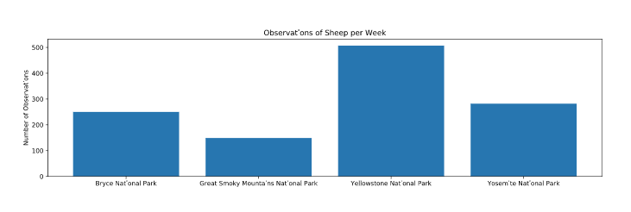
Sheep Observations in National Parks
Data presented indicating the number of sheep observations per national park.

Slide 10
Foot and Mouth Disease Study
An analysis of the sample size required to study Foot and Mouth disease in sheep at Bryce National Park found:
Researchers must observe 510 sheep to show significance
Approximate time to observe this many sheep is:
One week for Yellowstone
Approximately 2 weeks for Bryce National Park

